Slide 1
BLACK FRIDAY DATASET PRESNTATION and steps in data science
By Keith Martin C.E.O at Deep Thinkers Analytics

Slide 2
Steps in Data science
In 1997, University of Michigan statistics professor C.F. Jeff Wu distinguished the modern practices that were evolving from traditional aspects of statistics.
They include:
Data Collection
Data Analysis
Data visualization (of the results also)
Data modeling
Problem Solving and Decision Support

Slide 3
CRISP-DM
CRISP-DM, which stands for Cross-Industry Standard Process for Data Mining, is an industry-proven way to guide your data mining efforts.
As a methodology, it includes descriptions of the typical phases of a project, the tasks involved with each phase, and an explanation of the relationships between these tasks.
As a process model, CRISP-DM provides an overview of the data mining life cycle.

Slide 4
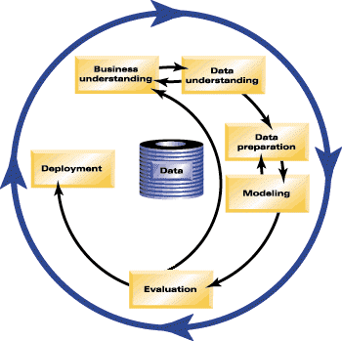

Slide 5
PANDAS
.nunique - function return Series with number of distinct observations over requested axis
.unique - returns unique values
https://www.youtube.com/watch?v=dye7rDktJ2E&t=3605s by Daniel chen

Slide 6
outliers
What is an outlier ?
-An outlier is a data point in a data set that is distant from all other observations. A data point that lies outside the overall distribution of the dataset.
Your takeaway – How to identify outliers in data and how to deal with outliers.
Hint – Using the Z-score in the stats library

Slide 7
Variables
Types of variables:
-Categorical - These data have meaning as a measurement eg. weight
Continous and Discrete
-Numerical - Categorical data represent characteristics such as a person’s gender
Ordinal data is data which is placed into some kind of order or scale.
nominal data is gender; male and female

Slide 8
Types of plots
distplots
Kdeplot
rugplot

Slide 9
Types of regression
Linear
Polynomial
Multivariative
Ridge

